Slide 1

Airbnb in New York City Analysis
Group 3
CIS 9650

Slide 2

Agenda
Introduction
Summary of Dataset
Data Visualization
Statistical Analysis

Slide 3

Introduction

Slide 4
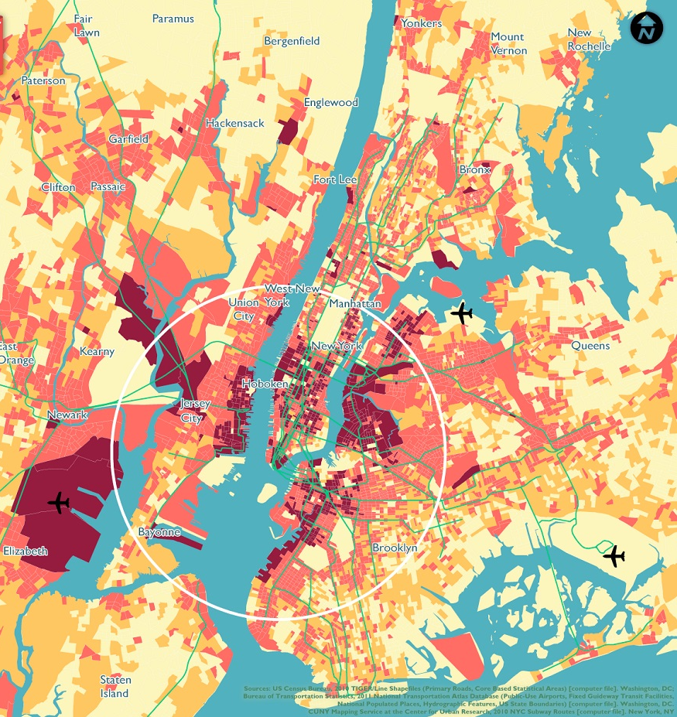
2. Summary of Dataset

Slide 5
Description of Dataset

Slide 6
Data Cleaning

Slide 7

3. Data Visualizations

Slide 8
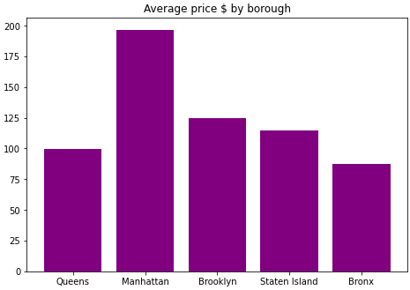
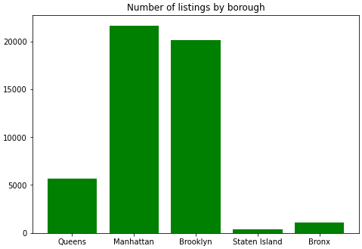
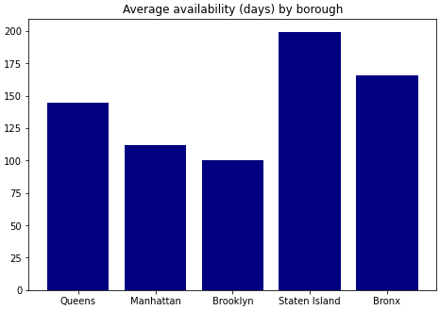
General Observations by Borough

Slide 9
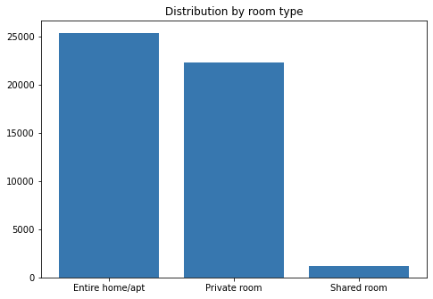
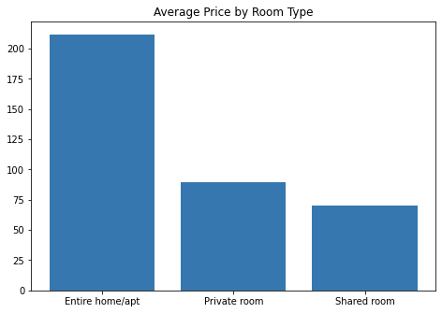
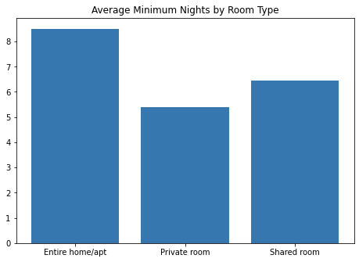
General Observations by Room Type

Slide 10
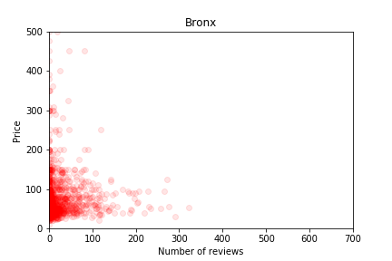
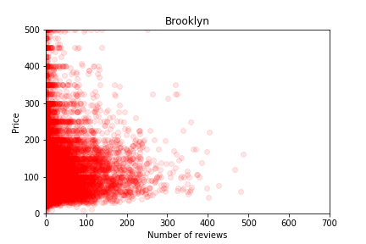
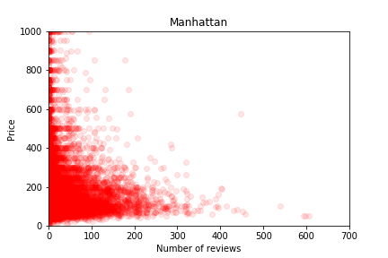
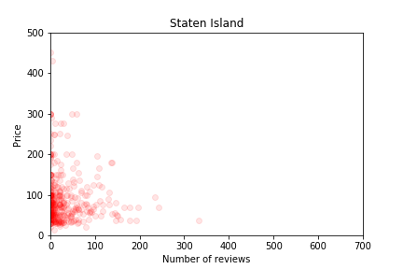
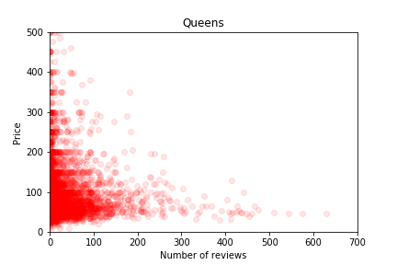
Price vs Number of Reviews
Notes:
Generally, the lower the price (but not too low), the more number of reviews

Slide 11
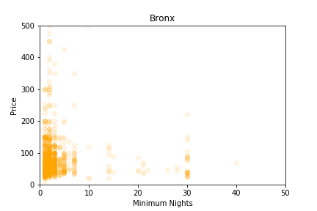
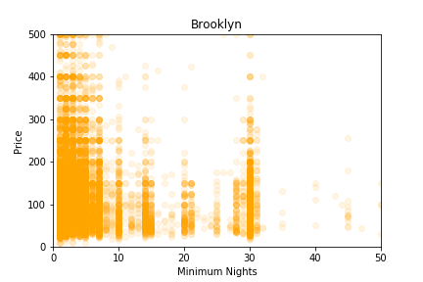
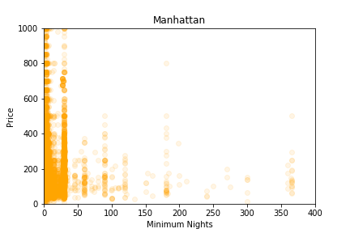
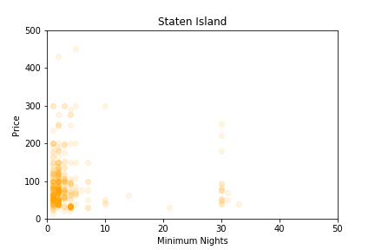
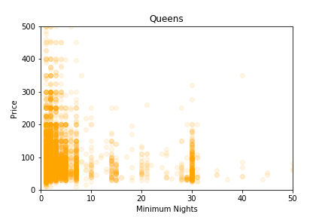
Price vs Minimum Nights
Notes:
Minimum nights go by intervals, clearest in Brooklyn and Queens. For 4 boroughs, after 10, it goes by interval of 5. For Manhattan, it goes by intervals of 30.

Slide 12
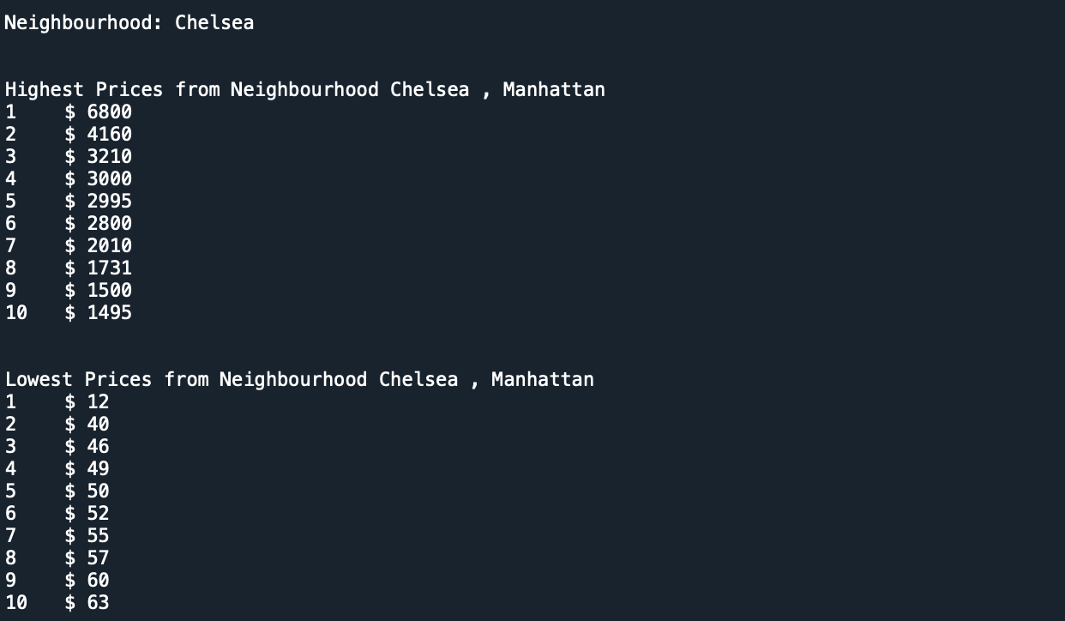
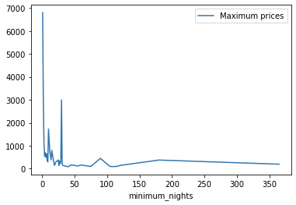
Price by Neighborhood

Slide 13

4. Statistical Analysis

Slide 14
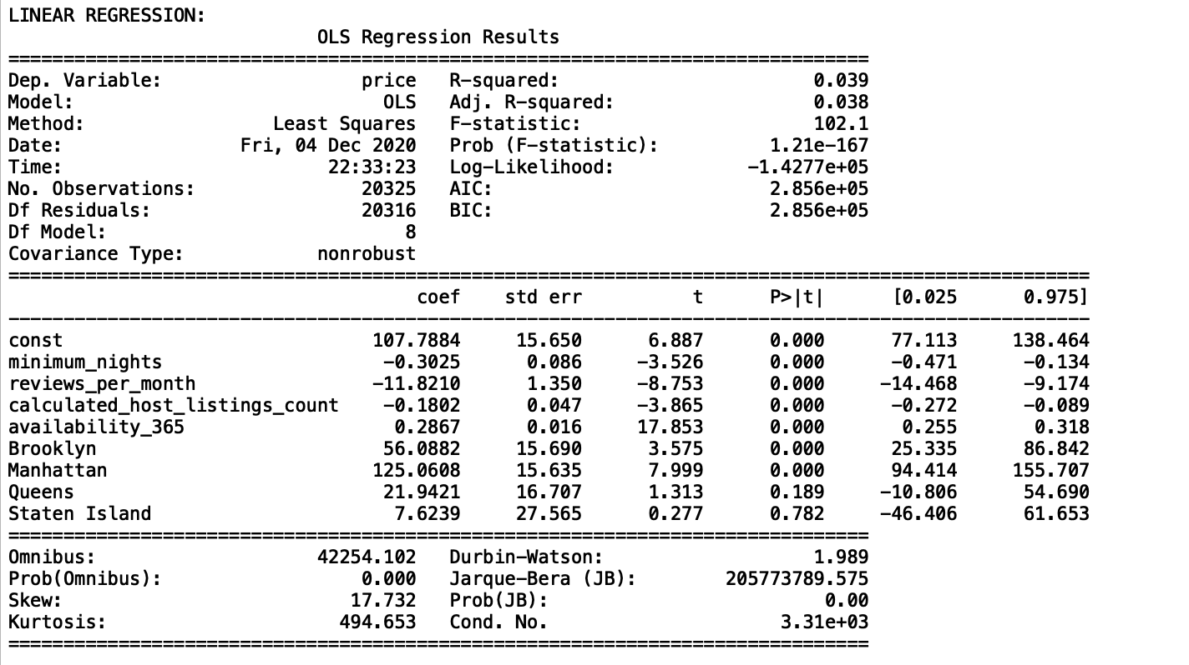
Linear Regression:
We did a linear regression analysis to see the effect of the above variables on the price. Although some predictor coefficients are significant but the R-squared value is extremely low (0.039). Only 3.9% of price variability comes from those variables. Therefore the model cannot predict the price. Mean squared error: 92699.09
Notes:
Note that Borough is a categorical variable. It is converted to a dummy variable which is three columns of boolean values.

Slide 15
Regularization:
Applying Ridge and Lasso regression as two regularization method improved the Mean Sum of Squares but it did not improve the model over all. Regularization parameter were obtained by 5 fold cross validation. (1 for Ridge and 0.01 for Lasso)
Ridge and Lasso
Train RMSE | 271.95
Train R-Squared | 0.038
Test RSME | 304.46
Test R-Squared | 0.0308

Slide 16
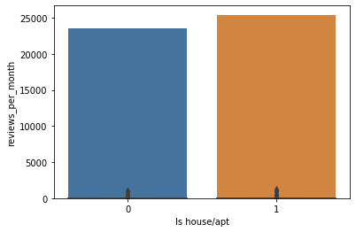
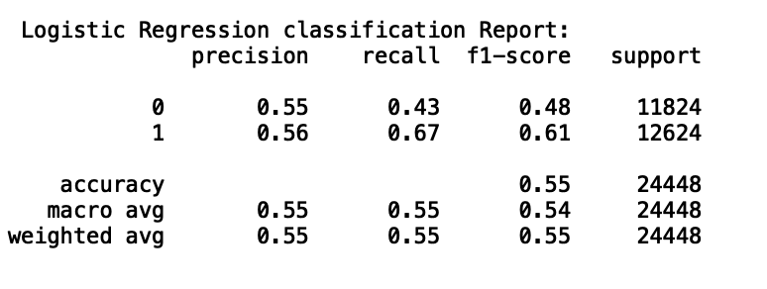
Predict Type of a Property
Binary Classification with Logistic Regression and Random Forest:
We would like to see if “Latitude”, “Longitude”, “Minimum nights” “Reviews per month”, “Listing counts” and “Availability” can predict if the property is the entire house/apartment or it is a room.
Logistic Regression Confusion Matrix
5060 (True Negative) | 6764 (False Positive)
4149 (False Negative) | 8475 (True Positive)
Random Forest Confusion Matrix
8049 (True Negative) | 3775 (False Positive)
3472 (False Negative) | 9152 (True Positive)
Accuracy Score
Logistic Regression | 55%
Random Forest | 69%

Slide 17
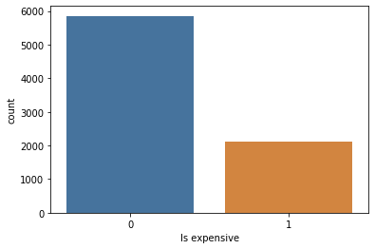
Binary Classification with Random Forest:
We would like to see if “Minimum nights” “Reviews per month”, “Listing counts” and “Availability” can predict if the price of a private room in Manhattan is above average or below average by applying Random Forest method. 70% of the data is used for the train and 30% for the test set
Random forest Confusion Matrix
 | Predicted False | Predicted True
Actual False | 1564 | 165
Actual True | 474 | 148
Standardized Confusion Matrix
0.66 | 0.07
0.20 | 0.06
The score for Random Forest is 0.72. That mean only 72% of time it predict correctly whether a room in Manhattan is expensive or not compared to the mean

